Slide 1
Global Superstore Data
Warehouse
Group 4
Ananya, Joel, Nathaniel, Bang, Shreyas

Slide 2
Create Tables
01

Slide 3
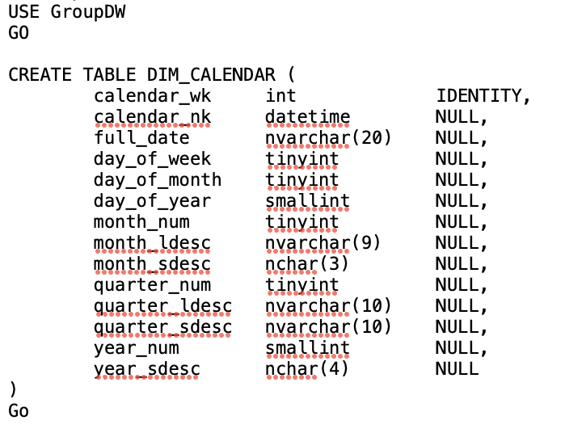

Creating Dimension /Fact Table
We start off by constructing the dimension tables for:
Calendar
Customer
Product
Location
Orders
Each dimension table has a warehouse key that is sequentially added to each row using the IDENTITY function
For each dimension table we define an index which simply points to where the data is and makes querying and updating of records quickers
Using the ALTER function we make the warehouse key the primary key of the tables

Slide 4
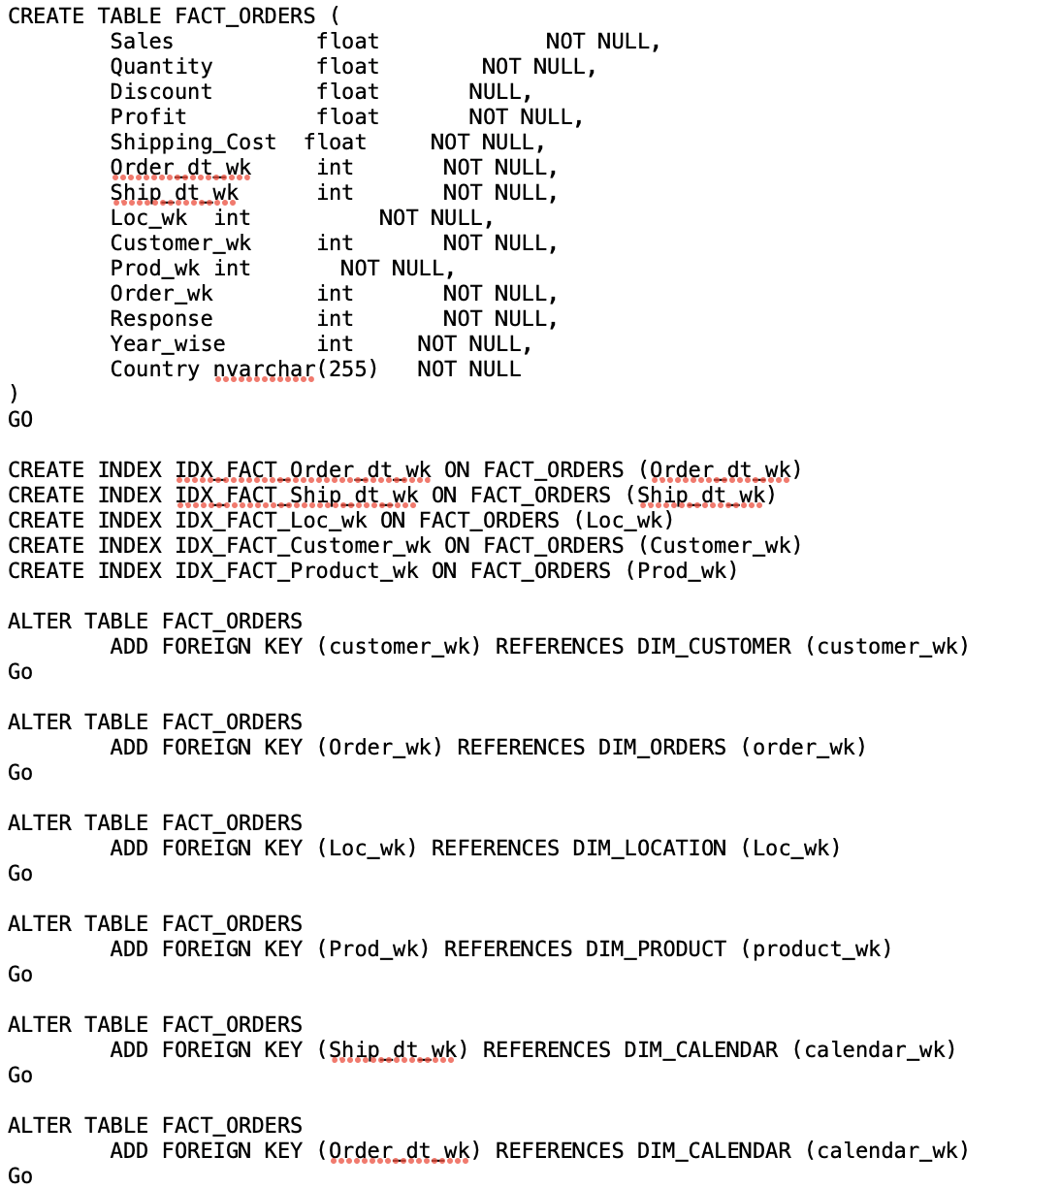
Creating Dimension/Fact tables
The processes and steps mentioned in the previous slide is repeated for every dimension table
In this step we will be constructing the fact table. Here we input the sales,quantity,discount columns as well as warehouse keys columns.
The fact table warehouse keys columns reference their respective dimension table warehouse key as foreign keys, creating a link between the dimension and fact tables.
We also define indexes on the warehouse keys to improve query/search and update results

Slide 5
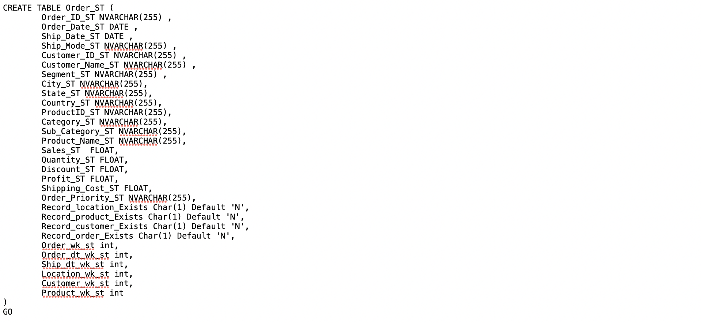
Creating Dimension/Fact tables
In this part of the script we create the staging table and add all of the respective staging columns as well as the warehouse keys columns

Slide 6
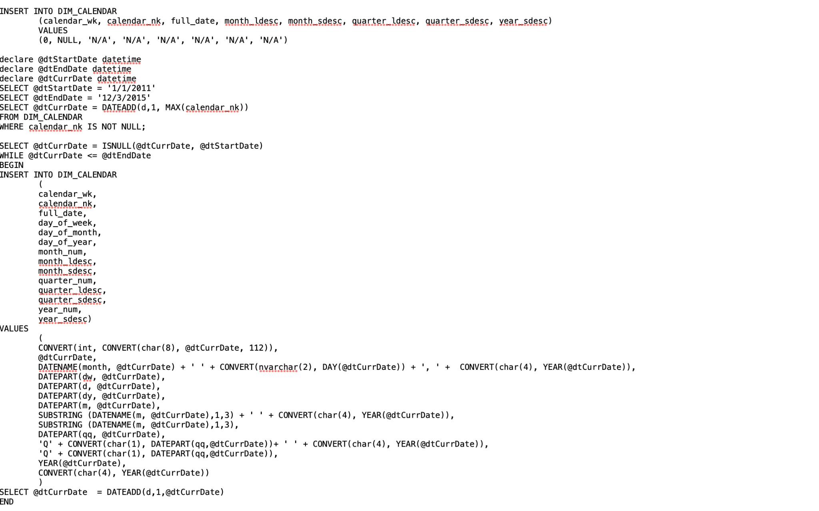
Creating Dimension/Fact tables
In this section we are populating the calendar dimension with dates between a given range from the dataset

Slide 7
02
SOURCE TO STAGING

Slide 8

TRUNCATING STAGING TABLE
Before doing another cycle of ETL, everything in the staging table which comes from the previous ETL need to be removed. Therefore, the ‘TRUNCATE TABLE’ function is used. This command deletes all the data inside a table, but not the table itself.

Slide 9
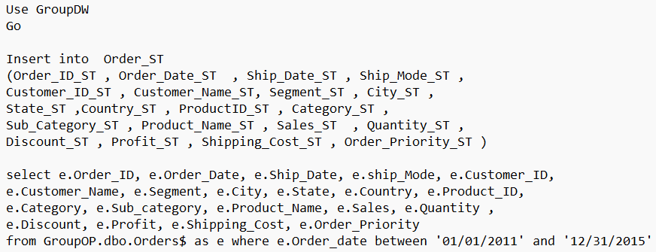
INSERTING VALUE FROM OPERATION TABLE
After truncating, the table is now empty and can be inserted with the next ETL cycle data. The appropriate data from the operation table are then inserted to the staging table using the ‘INSERT INTO’ and ‘SELECT FROM’ command. The ‘WHERE’ clause allows us to select the range of date for each ETL cycle.

Slide 10
03
STAGING TO DIMENSION

Slide 11
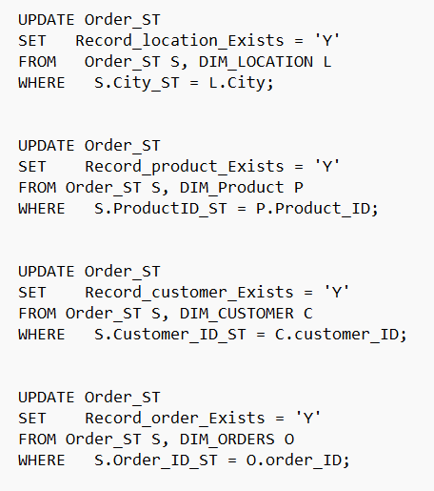
PREPARE STAGING AREA
In the staging area, we update the table.
We set column - “Record_location_exists ” as Y if the record exists in the dimension table as well.
This will be a flag for if the value exists in our dimension table or not.

Slide 12
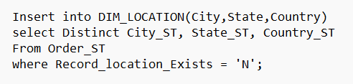
LOADING DIMENSION TABLES
Here, we only load into rows for which record_location exists is N. so we don’t load the same value twice.
We will repeat this for all other dimensions.

Slide 13
04
STAGING TO FACT TABLE

Slide 14
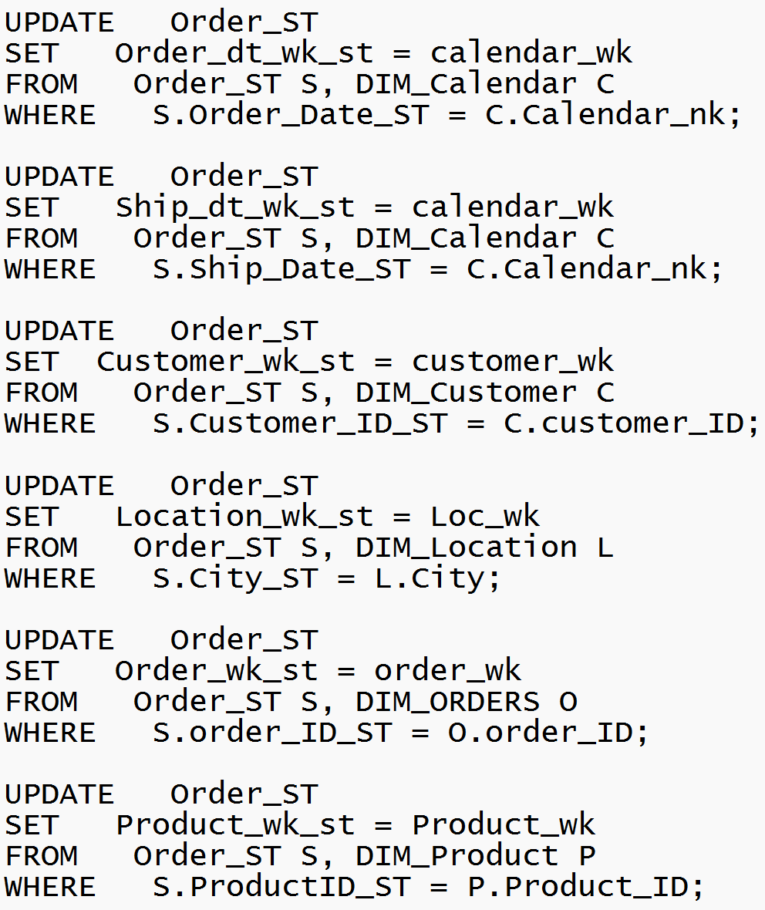
PREPARE LOADING TO FACT TABLE
After loading the data from operation table to staging, we also need to fill the data warehouse key columns of table Order_ST: Order_dt_wk_st, Ship_dt_wk_st, Customer_wk_st, Location_wk_st, Order_wk_st, Product_wk_st using ‘UPDATE’ and ’SET’ command.
We get the data warehouse keys from dimension tables for the same natural key using the ‘WHERE’ clause

Slide 15
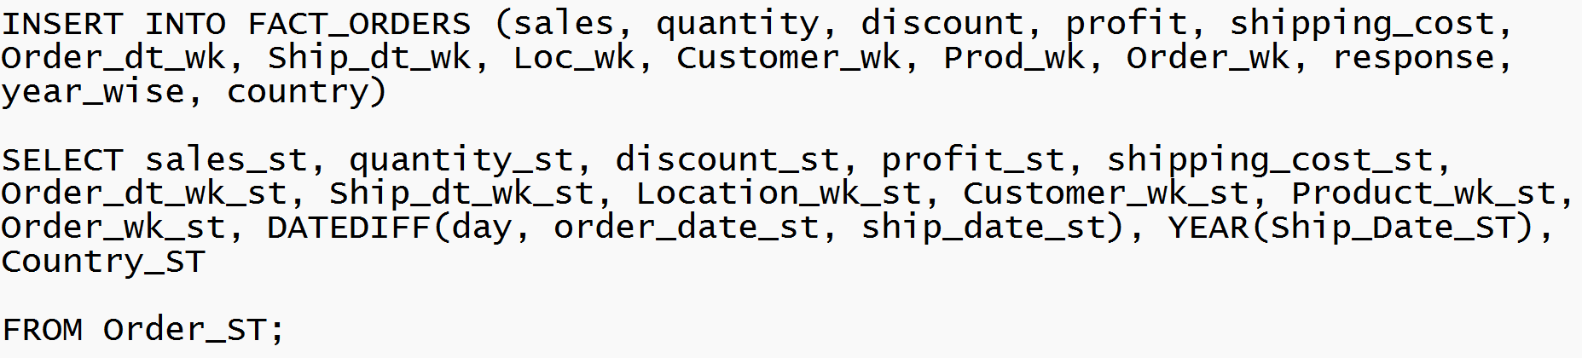
LOADING TO FACT TABLE
After updating data warehouse keys, we load the data from staging table to fact table using ‘INSERT INTO’.
To calculate the response time, we use the ‘DATEDIFF’ function to calculate the difference between order date and shipping date
Here, we use ‘YEAR’ function to get the year of shipping date as ‘year_wise’ column to answer business queries.

Slide 16
PIVOT TABLE AND SELECT QUERY
05

Slide 17
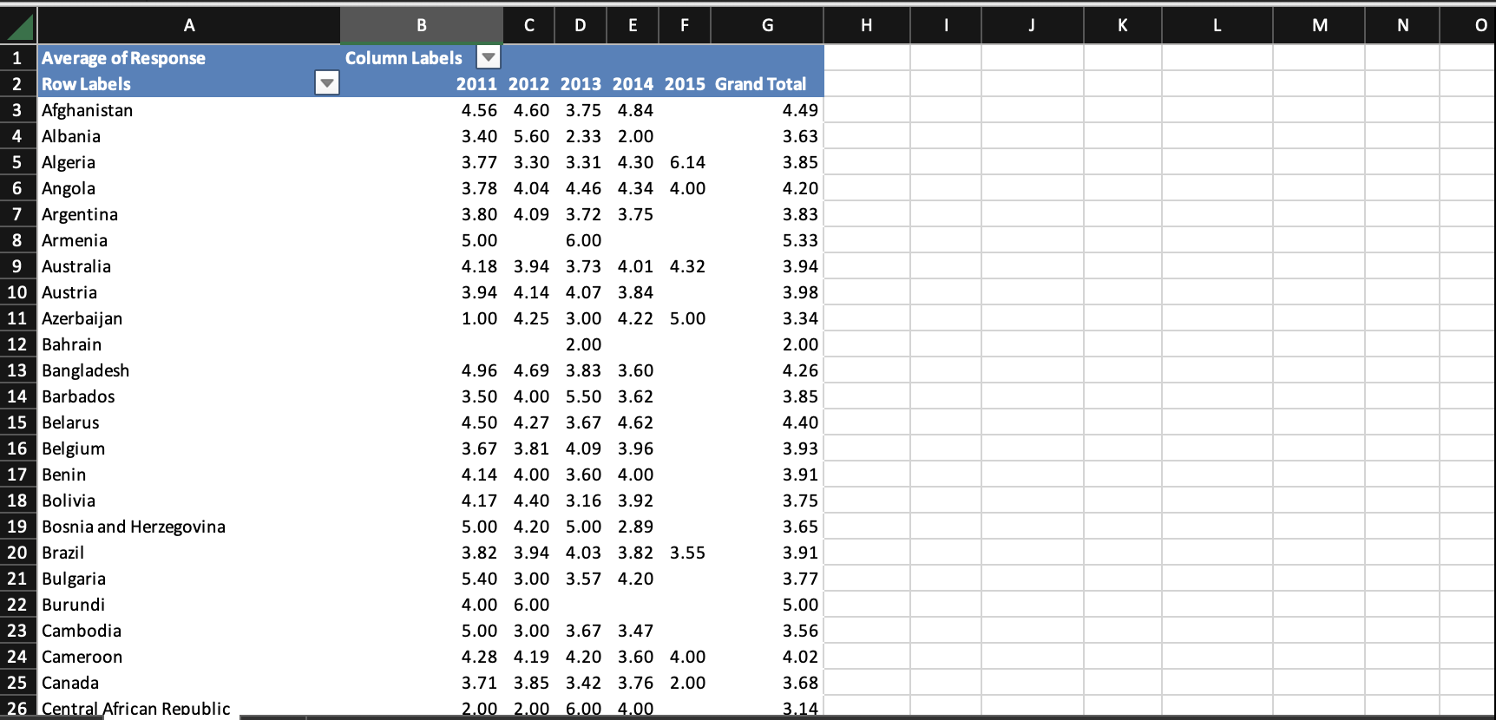
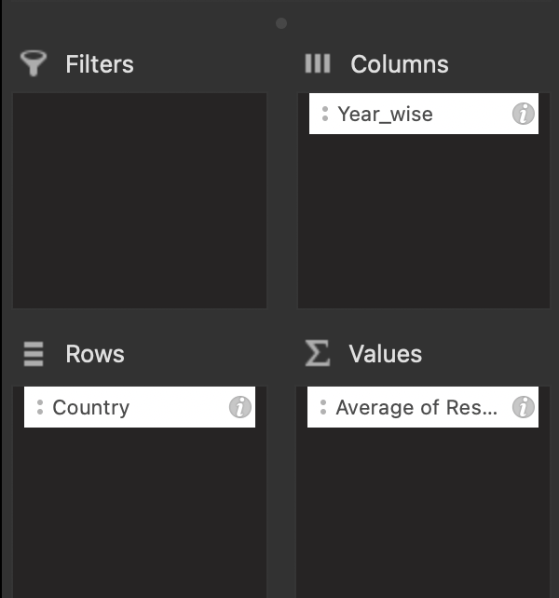
PIVOT TABLE
AVERAGE OF RESPONSE
It is calculated from the total days required for the product to reach the destination from the day it is ordered till it has reached the final destination.

Slide 18
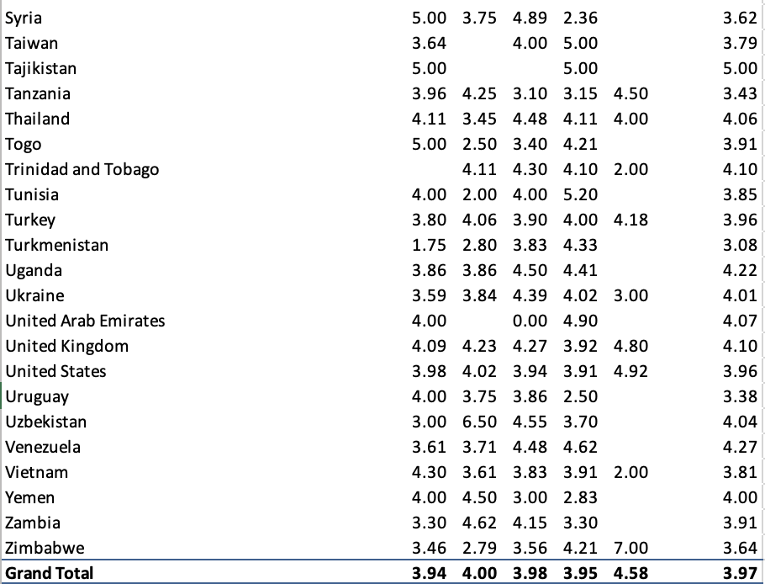
With the help of the pivot table, we
found the year-wise Average Response for each country.

Slide 19
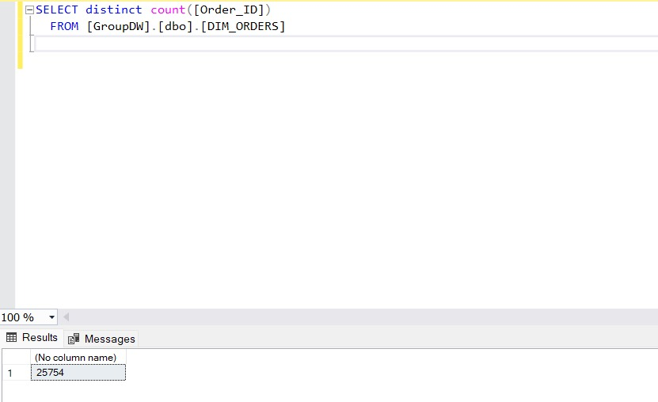
SELECT distinct count([Order_ID])
FROM [GroupDW].[dbo].[DIM_ORDERS]

Slide 20
THANK YOU

